Slide 1

BES171: 1) Banking 2) Finance 3) Insurance 4) Financial Inclusion
Debt
Corporate Governance
Equity
SENSEX
Companies Act
SEBI & Scams
Investment Funds
Derivatives

Slide 2

Corporate Governance: in danger?
TATA: Ratan vs Cyrus
Infosys: Murthy vs Sikka
Independent Director Wadia
Indian Pharma vs. USFDA
Companies Act?
LLP?
Notes:
http://indianexpress.com/article/business/companies/cipla-global-quality-chief-on-data-integrity-violations-bosses-pushing-juniors-need-to-be-whacked-4523459/

Slide 3
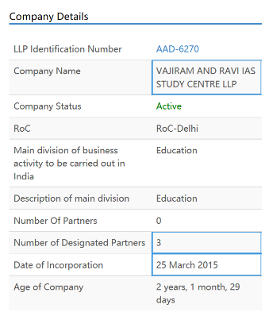


Limited Liability Partnership 2008
Individual proprietor
Partnership [MSME]
Companies Act
Tax & Tender benefit ☺
But compliance costs [CA, company Secretary, Account keeping] ☹
DFI, AIFI, IFC borrowing ☺
LLP-2008
Cheaper compliance for MSME than under Companies Act
Protects individual partner’s liability to his investment only. No joint liability or personal assets [e.g supplier, land lord-> can’t take away your home]
Notes:
https://www.zaubacorp.com/company/VAJIRAM-AND-RAVI-IAS-STUDY-CENTRE-LLP/AAD-6270

Slide 4
Companies Act 1956 ► 2013
Companies Act
2013
Public Ltd.
7-unlimited
Listed
Vodafone India.
Unlisted
Nokia India
One person
Private ltd.
2-200
Majority companies in India are registered as this
Section 8: Not for Profit Company [GSTN, NPCi]
Dormant Companies: not active for 2 consecutive years.

Slide 5
Companies Act 2013: Minimum authorized capital
Companies Act
2013
One person
1 Lakh
Private ltd.
2-200
1 Lakh
Public Ltd.
7-unlimited
5 Lakh
2015 Amendment: Min. paid up capital
None. So can start public or private ltd company, even with no amount in bank
Then issue shares/ bond etc., get finance…

Slide 6



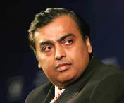


Governance structure of a company?
Shareholders
Board of Directors
Chairman
Managing Director
Operation
Profit->Dividend

Slide 7
No. of Directors (Compulsory under Companies Act)
Companies Act 2013
Public Ltd.
7-unlimited
One person
Private ltd.
2-200
1
Min. 2 Max15
Min.3- Max15
Why need them?
protect interest of (minority) shareholders
enforce corporate governance.
Independent Director Means
Promoter….. X
Pecuniary interest…X (except salary)
Employee…X
max in 7 cos
5 years x 2 terms x cooling off 3 years.
As per Companies Act
One director Indian resident (182 days)
One director Woman
1/3rd Must be independent

Slide 8
Companies Act 2013: meetings
BoD meetings
Minimum 4 meetings per year
Shareholders Annual General Meeting
One person company: no need
Public & pvt LTD. companies…yes
General notice by letter / email
Quorum (physically present): depending on # shareholders: 5 to 30
Proxy voting….Yes
Electronic Voting…Yes
Not > 120 days gap
Video conferencing…yes
Quorum: 1/3rd strength OR 2 directors whichever max. (one person company..X)
7 days prior notice
To ensure better corporate governance- this act provides for quorum, advance notice, e-voting.

Slide 9
Companies Act 2013: financial mismanagement?
Auditors
Individual auditor: 5 years
Audit firm: 5 year x 2
Cooling off: 5 years
Transparency, accountability
Full time Company Secretary: capital >Rs.5 cr
1 auditor: max 20 companies.
Whistleblower protection
Fraud report to Central government + shareholders' meeting
Company can’t give loans to directors/related people.
To ensure better corporate governance- act requires term limits on CA, tighter auditing & reporting norms, provision for whistleblower, company Secretary.

Slide 10

Corporate Social Responsibility on public ltd and private ltd.
Companies Act
Last 3 years' avg. profit=> 2% CSR spend (education, environment, public health, sanitation….)
Applies to?
net profit of 50 million (Excluding Tax)
net worth of 5 billion (Asset-liability)
turnover of 10 billion (sales excluding costs)

Slide 11
Statutory bodies under Companies Act 2013
National Company Law Tribunal (NCLT)
National Financial Reporting Authority (NFRA)
Investor and Education Protection Fund
SFIO Fraud

Slide 12

#1 National Company Law Tribunal (NCLT)
Companies Act 2013
Judicial + technical members
Finish case in three months
Appeal: NCLAT
Present case by Self, Lawyer, CA, CS
Cases:
Arbitration, compromise, M&A
Converting Public ltd. To private ltd.
Filing Class action suits (Satyam investors)

Slide 13

#2: National Financial Reporting Authority (NFRA)
Companies Act 2013
1 Chairman + 15 members
Set Accounting standards
Powers of civil court
Professional misconduct of CA/accountant=> debar
Appeal: NFRAA [appellate authority]
ICAI unhappy due to overlapping functions (Chartered Accountants Act, 1949)

Slide 14

#3: Investor and Education Protection Fund Authority
Companies Act 2013
As such existed since 1956’s company act, Under Corporate Affairs Ministry
Unclaimed dividend, interest, principal used for Awareness, seminar, financial literacy.
Participation from RBI, SEBI, experts
Companies Act 2013: it became a Statutory authority
@Delhi HQ, Regional offices
Corp. Affairs Secretary = Chairman
Members:
RBI Executive directors
SEBI Executive directors
Legal experts et al.

Slide 15


#4: Serious Fraud Investigation Office (SFIO)
Companies Act 2013
Based on Naresh Chandra report on Corp. governance, 2003: under Corp. Ministry
Cases: Satyam, Reebok fraud, Sesa Goa invoice, Saradha Chitfund
Now it’s a Statutory body
Examine documents, Search seize arrest, and gets CrPC powers of “investigator”.
Once SFIO gets case, other agencies can’t proceed.
State police, CBI –have to cooperate, provide documents & witnesses.

Slide 16

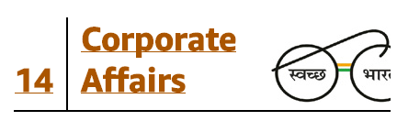
Statutory bodies under Companies Act 2013
National Company Law Tribunal (NCLT)
National Financial Reporting Authority (NFRA)
Investor and Education Protection Fund
SFIO Fraud

Slide 17

Ministry of Corporate Affairs looks after
Acts
E-governance
1 Service
Indian Corporate Law services (2008)
MCA-21 via PPP-BOOT mode. For companies act administration
INC-29 form to start new company
Registration
Companies Act ‘13 & ‘56, Competition Act ‘02,
I&B code’16 [Concurrent List]
1 Fund
Unclaimed dividends-> Investors Education & Production Fund (IEPF)->consolidated Fund
CA Act, Companies Secretary Act,
Limited Liability Partnership Act 08, Partnership 1932 Act among others

Slide 18
Corporate Governance: in danger?
TATA: Ratan vs Cyrus
Infosys: Murthy vs Sikka
Independent Director Wadia
Indian Pharma vs. USFDA
Companies Act?
LLP?
Notes:
http://indianexpress.com/article/business/companies/cipla-global-quality-chief-on-data-integrity-violations-bosses-pushing-juniors-need-to-be-whacked-4523459/

Slide 19



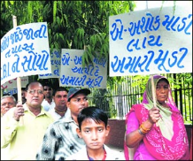
But why should we bother about TATA Sons?
LIC
36k cr in Tata companies
Weak / Collapse
Claim settlement? Future premium ▲: Financial inclusion ▼
Future Startup IPO: LIC may not invest, even if genuine.
Dividend, CSR ☹
Jobloss ☹, flight of FPI
Hence, Corporate Governance is important for economic stability of India

Slide 20
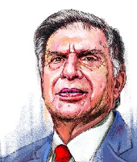
Mistry Regime (2013-16): Profit down 6800 cr.->2700 cr.
Tata Sons (Holding Company)
Jaguar
Steel
Motors
TCS
Ratan Tata Trust (23%)
Pallonji Mistry Trust (**%)

Slide 21
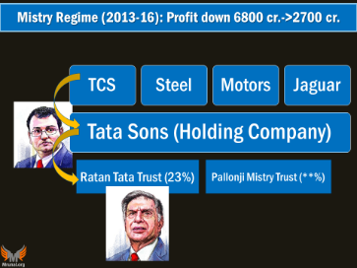
@Tata Son’s Board Meeting
Ratan Group
Resolution to remove Mistry
Unanimously removed Mistry
Mistry’s defense
inherited problems,
Aviation business (Tata-Visatara Singapore),
Telecom Tata-Docomo headache.
Ratan-ji too much interference.
Corporate ‘mis-governance’.

Slide 22


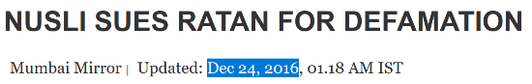
Mistry Regime (2013-16): Profit down 6800 cr.->2700 cr.
Removed as director
Nuslia Wadia Removed as independent director
Tata Sons (Holding Company)
Subsidiaries Co #1
#2
#3 Tata Motors
#4 Tata Steel
Ratan Tata Trust (23%)
Pallonji Mistry Trust (**%)
Removed as Chairman

Slide 23
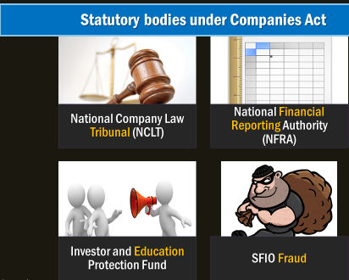
Mistry’s NCLT appeal
Replace Tata son’s current board
Appoint Retd. SC judge as non x/o chairman
Stop my ejection from Tata’s subsidiaries companies
April 2017
Rejected the application

Slide 24
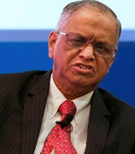
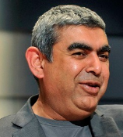

Murthy (Founder) vs Vishal Sikka (CEO)
Infosys
Cash reserve $5.25 bn-> share buyback
Call centre not generating enough $$
CEO spending too much on corporate jet. Annual package $11 million! [when other’s salaries down]
Mistakes in acquisition, chief financial officer removed to keep hush-hush he was paid “17 cr.” as severance pay.
Sikka-Counter: done with Board approval, Murthy degrading company’s name.
Kiran Majumdar Shaw (ID): no breakdown of corporate governance.

Slide 25

Pharma-sector Data integrity issue, Park Doctrine.
USFDA
To fulfil production Targets driven industry: Drug studies, Q&A not sufficient time given; good manufacturing practices (GMP) not followed.
When USFDA inspectors come, can’t prove drug’s purity, potency, GMP etc.-> Generic drugs banned.
CEOs give impossible targets. Whistleblowers get booted.
USFDA: “Park Doctrine”- CEO can’t pretend he did not know. (GSM2)

Slide 26
Corporate Governance: “Definition”
Way of directing the company
To protect stakeholders’ interest
And ensure
Legal-regulatory compliance
Technical compliance (pharma)
Moral-ethical compliance (Infosys)
Absence: fraud, mismanagement.
Body: How it harms entire economy <LIC- TATA slide>
Conclusion: hence, imp.

Slide 27
Corporate Governance: in danger?
TATA: Ratan vs Cyrus
Infosys: Murthy vs Sikka
Independent Director Wadia
Indian Pharma vs. USFDA
Companies Act?
LLP?
Notes:
http://indianexpress.com/article/business/companies/cipla-global-quality-chief-on-data-integrity-violations-bosses-pushing-juniors-need-to-be-whacked-4523459/

Slide 28
BES171: 1) Banking 2) Finance 3) Insurance 4) Financial Inclusion
Debt
Corporate Governance
Equity
SENSEX
Companies Act
SEBI & Scams
Investment Funds
Derivatives

Slide 29

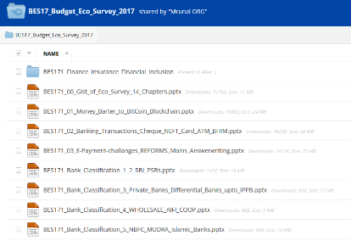
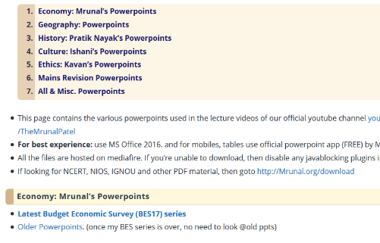
Old material demonetized and decontentized
Mrunal.org/PowerPoint
Download files individually.
If you select to download multiple files at once, then ERRORs.

